Slide 1


NY top zipcodes Time Series

Slide 2

Hi there! I’m a software engineer based in NY and working for the UN, and an aspiring data scientist at Flatiron Academy
Barto Molina, Flatiron DS, April 2019 cohort

Slide 3

the problem
increasing relocations
renting vs. buying
optimize commuting time / ROI

Slide 4

the project
NY, NJ, CT - UNHQ
commuting < 45 minutes
10-year ROI

Slide 5
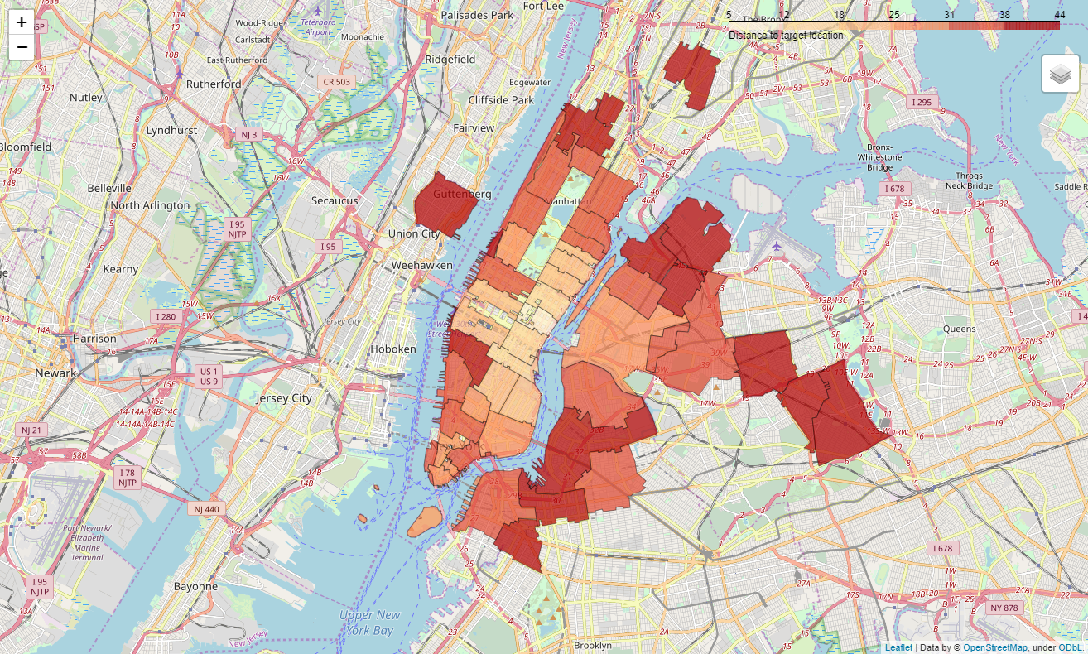
top zipcodes commuting distance

Slide 6
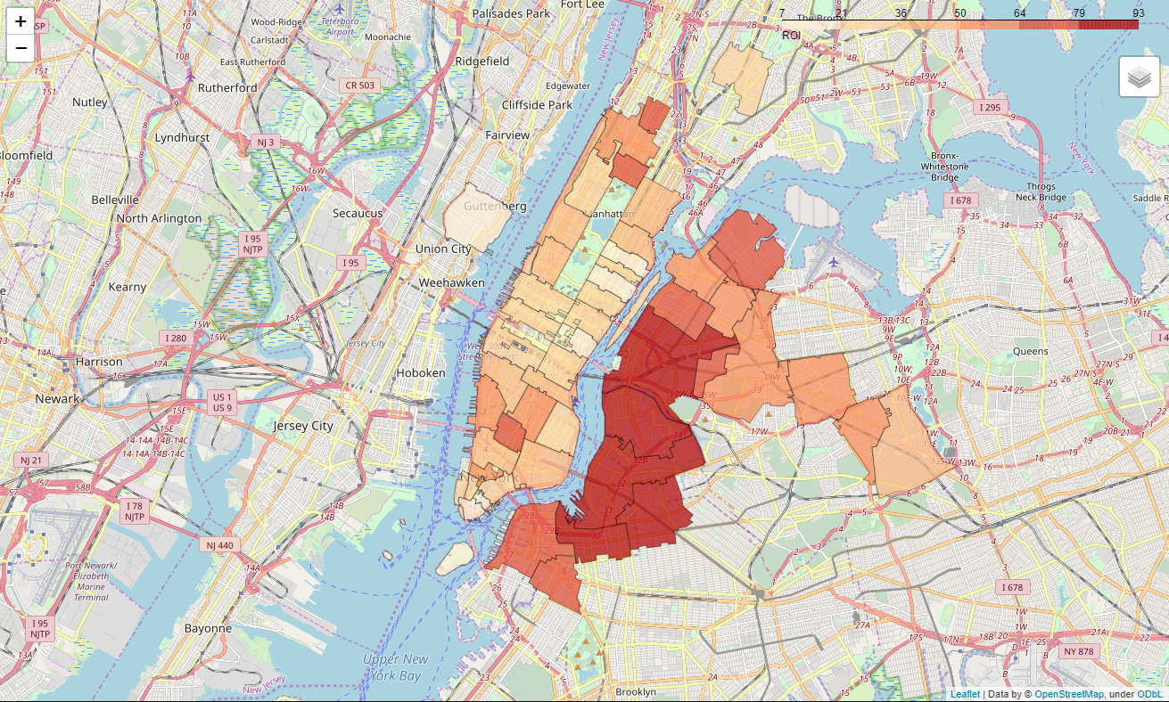
top zipcodes 10-year ROI

Slide 7
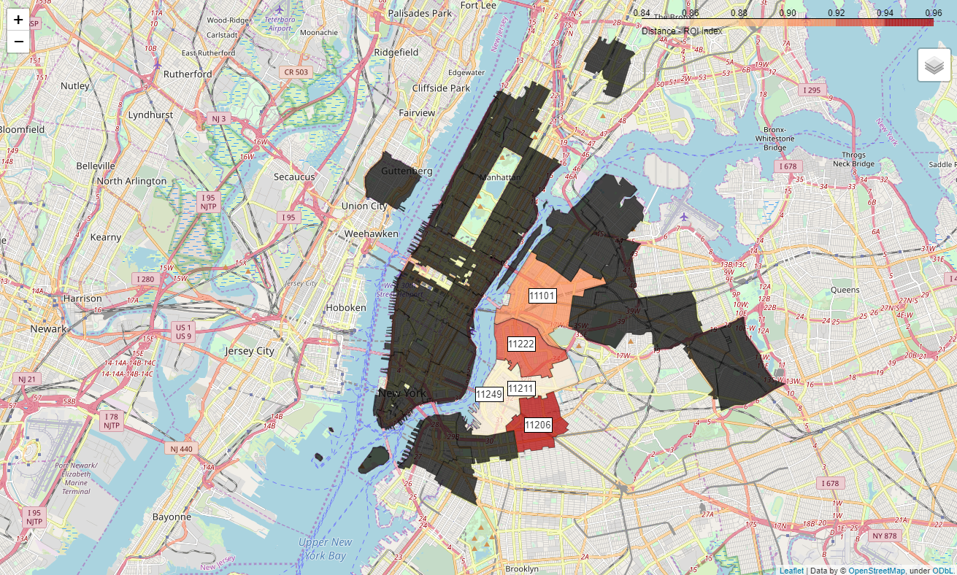
top zipcodes distance – ROI Index (DRI)
Top 5
Astoria
11101: 26m – 87% (91)
Brooklyn
11206: 37m – 93% (96)
11222: 36m – 91% (94)
11211: 41m – 82% (84)
11249: 40m – 87% (86)

Slide 8
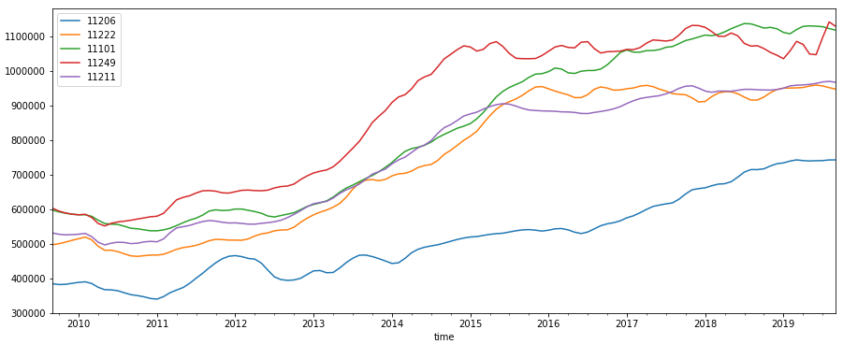
analysis monthly price

Slide 9
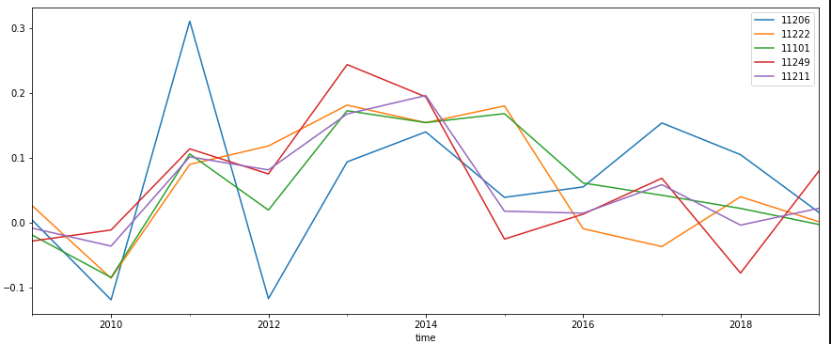
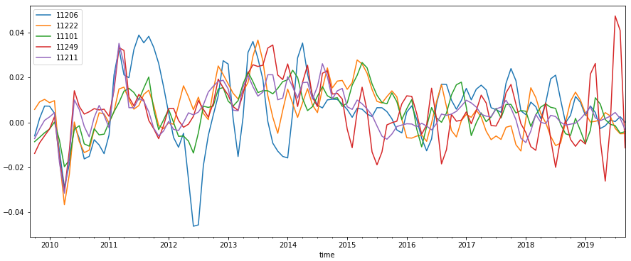
analysis yearly / monthly ROI

Slide 10
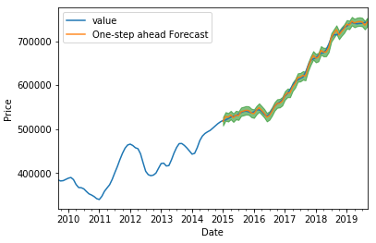
11206 fitting model

Slide 11
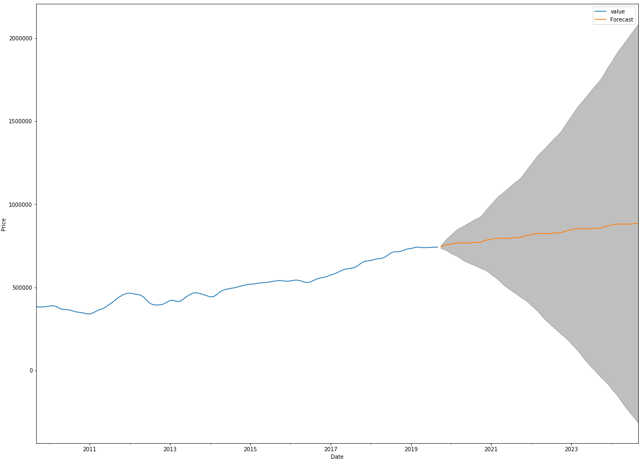
11206 5-year prediction SARIMA

Slide 12
recommendations future work
wide confident interval
additional models required
modelling additional zipcodes

Slide 13
thank you.

